Slide 1
Project ROI
Sylvie Appriou
July 25th, 2018

Slide 2
Agenda
Project background
Problem statement
Vision / Mission / Guiding principles
Strategy map
Make or buy decision
Project ROI
Conclusion

Slide 3










Supporting a Go-to-Market strategy with Sales Incentives
GTM
Strategy
Market
Segment
Sales Outcomes
Coverage
Model
Product
Offering
GTM
Strategy
Sales Behaviors
Compensation Models and
Incentive Plans
Geography
Routes to
Market
Capabilities = Policy + Process + Governance
+ Systems + Data

Slide 4

Sales Compensation process
Sales Compensation process
Assign Comp
Plan
  Create
  Goal
  Sheet
  Manage
  hierarchies
  & Territory
  Definition
  Sales
  Credit
  Claiming
  &
  Adjustment
  Pay
  Commn
  Visibility
  & Reporting
Comp plan
Product = 90%
Service = 10%
Goal sheet
Product goal =
10 M$
Service goal =
2 M$
Sales Territory
Account X
Account Y
Sales Credit
Assign all orders
for Customers X
and Y to Sales
person
Adjustment
Adjust Sales
Credit
Calculate
Commissions
Calculate product
Achievement
Calculate Service
Achievement
Calculate
Commissions
YTD revenue
divided by
Yearly goal
% YTD achievement
determines
Sales person
Compensation factor*

Slide 5


Current Business Situation
Go To Market Strategy
Inability to Influence Sales Behavior
Missing Basic Capabilities
Inability to Measure and Improve Comp Plans
Productivity
Manual, Localized Process
High Operations and IT Costs
37:1 Payee to Admin Ratio
Overpayments
System Integrity
Claiming
Notes:
Go To Market Strategy:
1. The compensation planning process is too complex, and as a result, sales people do not understand the plans or the process. To drive sales behavior, we need to simplify the plans and process.
2. Today, we have no hurdles, multipliers, or matrix capabilities. These are standard compensation planning tools in the industry, and are required just to catch up with Cisco’s competition.
3. We can not measure and improve compensation plan effectiveness today, due to a lack of visibility.
Productivity:
We have unaligned and highly manual processes WW.
For example, Foundation Advantage requires the ability to pay over 10,000 payees manually, outside the current systems.
Over 77% of sales credit transactions need to be manually touched
As a result, we have significant SOX and Audit risk, and low Customer Sat scores (what are they?).
2. 250 FT Equivalents WW on Sales Credit Ops and Comm Ops, FSAs, SBO, etc., at a cost of $40M/year.
50 FT Equivalents WW on G2C IT at a cost of $7M/year.
This doesn’t include the AMs spending time on claims and adjustments
3. There are approximately 37 payees for every person administering commissions. At that ratio, we are running at or below the efficiency of a company that has no G2C systems and pays commissions based on Excel spreadsheets.
4. In FY06 to date alone, we have discovered 4 overpayments (4 root causes, 3 process / 1 system), resulting in $4.9M of overpayments and affecting over 7,300 reps. There are also industry statistics that indicate companies without systematic commission payment audits are overpaying commissions by 2-10%. If we overpaying by 2%, that’s $15M per year.
5. 35 applications, 1.7TB of data replicated 4-7 times, 45 internal data interfaces. If each data interface is 99% reliable, we have a 40% chance of a problem. The G2C platform is 10 years old, poorly documented, and requires deep expertise to make even the most basic of changes. The bottom line is, I can’t guarantee the integrity of the G2C systems.
6. Amount of time spent by the field and FSAs on claiming and adjustments. For example, FSAs spend 1.5-2 hours per day on claiming 2-tier POS. While some of this is due to data issues, there are also system limitations driving productivity loss.

Slide 6
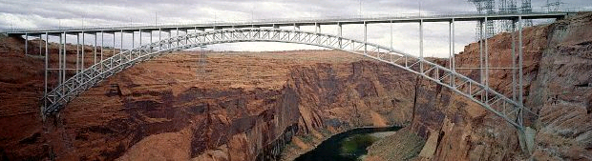
Business Capabilities GAP
Business
Capabilities
Now
Business
Capabilities
As It
Could Be
Business / System Capabilities
Policy & Governance
Data
Customer Segmentation
  Verticals and Market Segment
  Top / Strategic Customers
Product Segmentation
  AT, Product Specific
  SW and Solution Selling
  Attach Rate
Territory Management & Coverage Tracking
Attribute Based Compensation
  - Revenue, Margin, Discount
Enhanced Comp Plans
  Hurdles, Multipliers, Caps, Matrix
  Multi-year Deals
Channels and Acquisition Models
  OEM Models
  Stock and Managed Services Process
Overlay Automated Support
Automated Bonus Programs
Compensation Modeling : “What If”
Workflow
Direct and Overlay Sales Credits (77% manual)
Step, Tiered Commission Calculation (single model)
Splits
Teams
Sophisticated End-to-End Field Reporting
Notes:
Current biz capabilities : « one size fits all model », limited capability in terms of sales coverage, comp modeling etc…
Reminder, we are not solving upstream data problems. While those problems do need to be solved by other initiatives, our focus in on Policy & Governance and on creating the business and system capabilities required to successfully address G2C for Cisco for the next decade.
To fully enable all of the Business Capabilities As It Could Be will require the data initiatives to be successful as well. Regardless, there are a good number of business capabilities that are primarily business/system capability dependent. As you can see, the capabilities that turned red are those that have a greater dependency on data. Once data quality and availability is improved in these areas, LTSD will have the flexibility to incorporate and automate these capabilities as well.

Slide 7
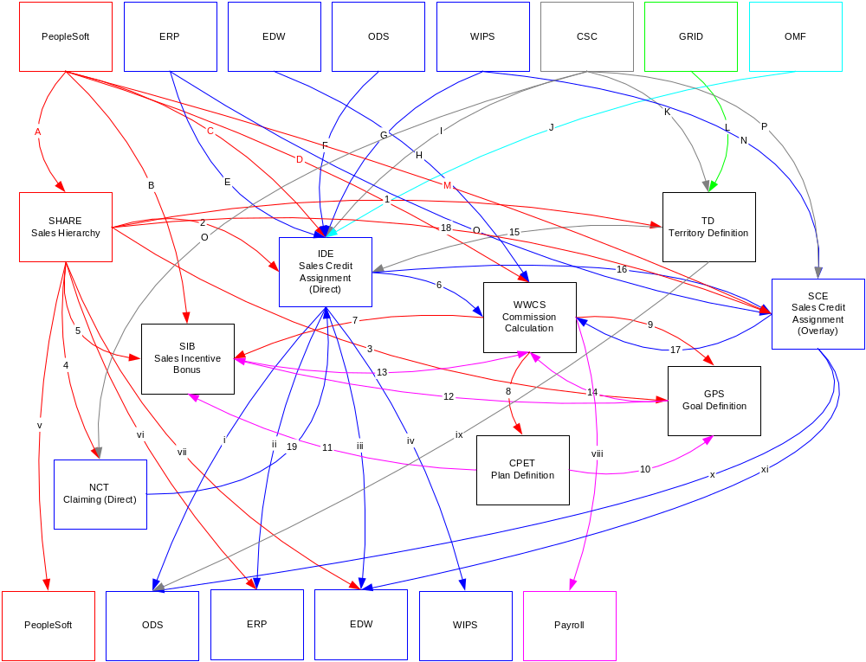
Current IT Situation
5 Different Sources for the Same Transactions
45 Internal Data Flows / Interfaces Within G2C Applications
7 Databases on 4 Different Servers
Complex Integration with Other Systems
Total Cost of Ownership Very High
Use of Non-standard Technologies
Unnecessary Processing
1.7 Terabytes of Data
Notes:
DESMOND: 35 applications, 1.7TB of data replicated 4-7 times, 45 internal data interfaces. If each data interface is 99% reliable, we have a 40% chance of a problem. The G2C platform is 10 years old, poorly documented, and requires deep expertise to make even the most basic of changes. The bottom line is, I can’t guarantee the integrity of the G2C systems.

Slide 8

Vision and Mission
Establish Cisco as the leading Sales Incentive driven company
Create a world class, agile and trusted compensation business and system architecture, with seamlessly embedded business controls, to effectively drive Cisco sales and partners behavior.
Notes:
GENERAL Definitions:
* Vision – A path that should not be changed, providing an insight into what is
“Core to Preserve” vs. “Future Possibility for Change”
(as interrupted from Collins J,C; Porras J.I. ; :Building your Company’s Vision” (1996))
* A Vision Framework is consistent of two major concepts:
Core Purpose ( defining What we stand for and Why we exist )
Core Ideology or an Envisioned Future ( defining Where we aspire to evolve, achieve and create )
* Mission – A definition of our fundamental purpose.
--------
G2C Definitions:
* Values – these are usually organizational and integral to a sense of who we are and what we represent.
( personal opportunities, building intent, consensus, etc. )
* Vision – the unchanging heart of the G2C strategy, a purpose & ideology.
* Mission – an articulation of where we want to take the G2C process & systems
--------
“ The benefit to be derived from setting ambitious goals is
that the status quo is never enough. The challenge itself
brings forth new ideas and excitement.
It encourages “Out-of-the-Box” thinking. ”
– Sir Brian Pitman, Lloyds TSB

Slide 9
Guiding Principles
Drive improvements based on customers / stakeholders and Cisco needs
Ensure value is realized by targeting business opportunities and validate using metrics (no integration for integration’s sake)
Minimal to no functional customization – use industry standards and best practices for context processes
Actively manage risks – use PLC best practices to deliver projects, i.e. “no big bang deployments”
One team, one plan, one voice via teamwork, partnerships and joint ventures
Be transparent in our efforts – drive efforts via enterprise level governance, communication and change management
Deliver results within the Enterprise Architecture framework

Slide 10




Different customers with different outcomes
Fiduciary and legal compliance
Reduced process cost of ownership, lower Opex
Accurate compensation accruals
- ROI on existing Comp models
- Drive targeted growth
- Quickly implement new comp models to support sales GTM strategies
- Visibility to Sales force performance
Exec Management
Finance Management
ICE
Sales
Sales Management
- Transparent and timely visibility to transaction flow from Entry to Payments
Timely Bookings reporting
Visibility to clearly defined territories
Timely, accurate and predictable payments
Motivated sales force
Improved sales productivity
Optimized market coverage
Ability to attract and retain top talents
Visibility to team performance

Slide 11
Strategy map
Customers
Commissionable
employee
Sales
Management
Sales and Finance
Operations
HR
Finance
Management
Cisco execs
Know
which
Customers
to target
Accurate,
timely and
predictable
payments
Timely visibility to
Bkgs-to-Payments
flow & Fcst / Goal
retirement
Visibility to
Market
coverage
Influence Sales &
Partners behavior
to support
GTM strategies
People
perceive
they are
treated fairly
Maximize ROI on
Compensation
paid and
cost of admin
Fiduciary +
Legal
compliance
Customer
Outcomes
Highly
Productive
Sales force
Ability to define and
change GTM models &
Comp plan to respond
to market conditions
Attract & retain
Effective
Sales force
Cisco viewed
as a company
With integrity
Competitive
objectives
Drive growth
Optimized
Market coverage
Lower Opex
Readiness
(YE and
acquisitions)
Accurate &
Timely Sales
Incentive
Payments and
information
Near real
time
Bookings
allocation
Effective
Market
coverage
Agility &
Time to
market for
new comp
models
Effective
Comp
Models to
drive GTM
strategies
Effective
Goaling
Total target
Comp meet
Target
Percent.
of market
Optimize
TCO on
G2C
Proc.
Core
Objectives
Compliance
checklist
Set up processes
and
Change
mgt
Payroll
Calculate
Variable comp
Design Comp
Plans and
Bonus
programs
Goaling
Benchmark
Cisco
against
Market data
Track admin
and
compensation
costs
Built in
Compliance
Business
Capabilities
Sales Credit +
Claiming + adjustments
Analytics &
Finance rptg
Comp plan
Modeling and
analytics
Define
Territories
Effective
Goaling

Slide 12
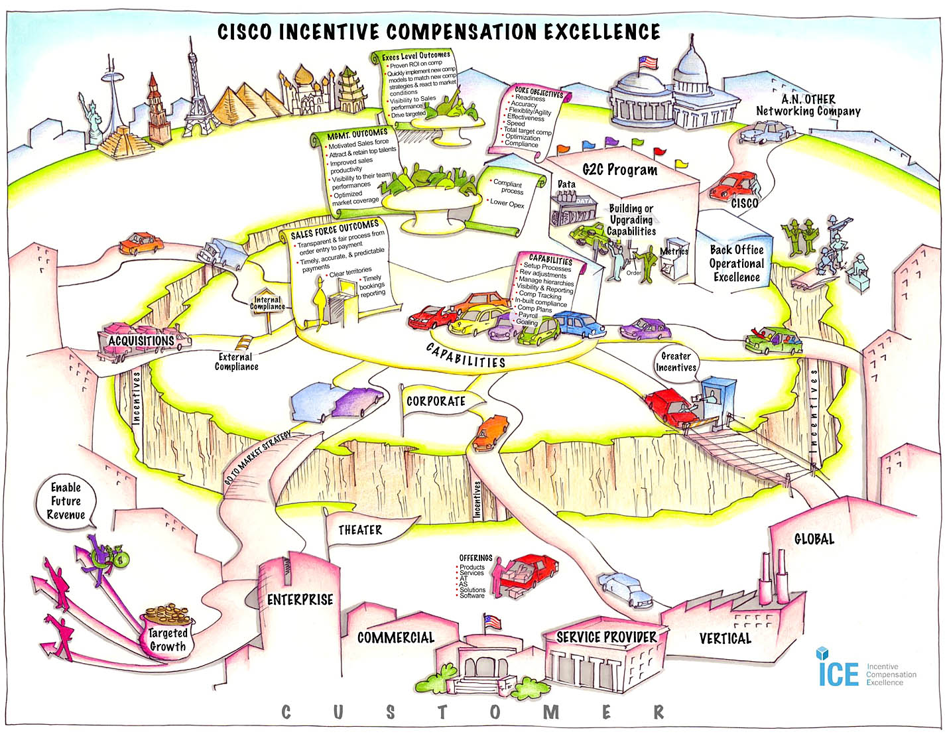

Slide 13
Make or Buy decision ?
Are the capabilities considered critical to the company competitive value or are they more Market standards ?
  Key to competitive advantage : in house development
  Market standard : off the shelf package
Drive improvements based on customers / stakeholders and Cisco needs
Ensure value is realized by targeting business opportunities and validate using metrics (no integration for integration’s sake)
Minimal to no functional customization – use industry standards and best practices for context processes
Actively manage risks – use PLC best practices to deliver projects, i.e. “no big bang deployments”
One team, one plan, one voice via teamwork, partnerships and joint ventures
Be transparent in our efforts – drive efforts via enterprise level governance, communication and change management
Deliver results within the Enterprise Architecture framework

Slide 14
Package selection process
Market evaluation
Reference checking
Internal review – POC Proof of Concept
Decision process
Global
Roll out
Vendor
Viability
Reference
Checking
Proof of Concept
Test-
Drive
Build
Pilot
Decision:
Vendor List for PoC
Decision:
Vendor Selection
Decision:
Go / No go

Slide 15
Example of Market evaluation (1/2)
Sales Incentive Compensation Management Market Scope, 1H04
Vendor
Viability
 | Strong Negative | Caution | Promising | Positive | Strong Positive
Callidus Software
Centive
Oracle
PeopleSoft
SAP
Siebel Systems
Synygy
Market Evaluation
250+ Requirements
Vendor Face-offs
Viability Scoring
Source: Gartner Research (January 2004)
Notes:
As part of our Market Evaluation, we collected industry analyst reports from Gartner, Giga and Aberdeen about the software vendors in the G2C space. This Gartner report is representative of the results: Callidus is rated the market leader in terms of feature/function and vision, Synygy is second with a highly flexible outsourcing model, and Oracle is a distant third with an “up-and-coming” rating for their continued investment in this space and their integration with ERP.
Our Viability Scoring confirmed that we are talking to the right three vendors, and that Oracle’s offering appears to still be well behind the other two.

Slide 16



Example of Market evaluation (2/2)
Vendor Profile
Year Established | 1996 | 1991 | 1986
Public/Private | Public | Private | Public
Product Name | TrueComp, TrueInformation TrueResolution | EIM10 | Oracle Incentive Compensation
Product Offering | Out of the Box | ASP, SDK | Out of the Box
2004 Revenue | $58.7M | $70M | $10.2B Corp
Employee Strength | 294 | 500 | 43,000 Total
# Customers in Production | 75 | 75 | 165
# Customers with Signed Contracts | 120 | 75 | 165
Comparable Customer List | Novell, Apple, Sun, Sprint, SBC, Allstate, HP | Wyeth, Pfizer, Xylinx, Johnson & Johnson | EMC, SGI, Nordstrom, British Telecom, La Poste
Vendor
Viability
Market Evaluation
250+ Requirements
Vendor Face-offs
Viability Scoring
Notes:
As I mentioned, Callidus is the market leader in the G2C space. They are a public company, and have the strongest customer base in the high-tech manufacturing and distribution industry, with installations at Sun, Apple, Novell, NetApp and Autodesk, and a recent contract with Hewlett-Packard. They have an out-of-the-box software application suite that addresses G2C best practices holistically.
Synygy has been very successful over the past fifteen years in supporting their customers with an outsourcing (ASP) model. While they have recently gotten into selling their product as software, their product is similar to a software development kit that allows extensive flexibility at the cost of maintainability. Synygy’s strongest client base is in the Pharmaceuticals industry.
Oracle has recently completed its acquisition of Siebel, and now adds Siebel and Motiva to its Oracle Incentive Compensation offering. The company does not disclose revenues or people assigned to a specific product area. They have a cross-industry coverage model, as you can see from their Comparable Customer List. It will be interesting to see whether and how successfully Oracle integrates its potpourri of Incentive Compensation solutions.

Slide 17
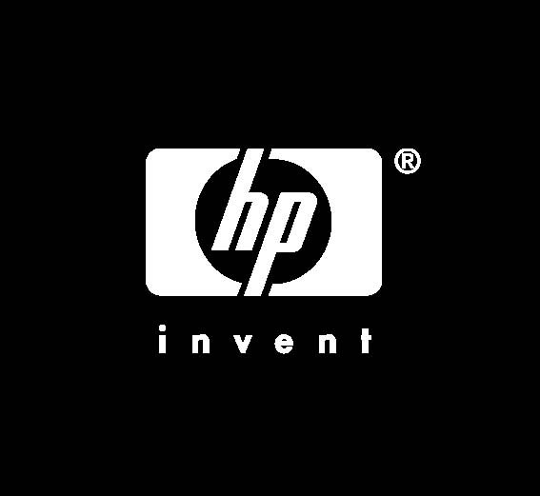

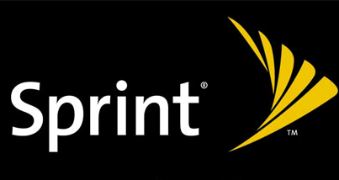
Reference checking
Reference
Checking
Jim Parker, WW Commission Manager, Novell
“We define compensation plans only on available data attributes…”
“The EIM solution’s complete data and audit trail has made
Sarbanes-Oxley straightforward.”
“We exceeded our 60% support cost reduction target.”
Gary Goelkel, Worldwide Sales Compensation IT Director, HP
“We realized that our business processes were far from industry best practices and the only way to force our organization into the desired behavior was to buy an off-the-shelf incentive compensation software package."
Mark McKinney, Manager of Systems Development, ITS Commissions, Sprint
“Sales force confidence and satisfaction with the commission system grew dramatically.”
Carefully Selected Reference Accounts
70+ Questions, In-depth Assessment
Notes:
Through our reference checking process, we confirmed again that we are talking to the right software vendors in the G2C space. Almost everyone had considered Callidus and Synygy, and those with an Oracle infrastructure had also evaluated Oracle.
We also brought in Quovera’s Sales Effectiveness practice, and they confirmed that we are not missing any viable software vendors. So the Market Evaluation, our own Viability Scoring, the Customer References, and a 3rd party expert all confirmed that we have the right vendors in the picture.

Slide 18

Proof of concept
Comprised of 22 Business Participants:
Theatres
US/Canada
Japan
APAC
Europe
Emerging Markets
Processes
HR Compensation
Sales Credit Operations
Commissions Operations
G2C Readiness
SHARE/STT
Groups
CA
Inside Sales
Global Accounts
Channels
Advanced Technologies
Acquisitions
Proof of Concept
Bottom-up, Theatre Buy-in, Sales, SF
79 Use Cases
400+ Functional Requirements
PoC Read-out
Weighted Scoring
Notes:
(Highlight the geographic and cross-functional scope of the PoC team)

Slide 19

ASP Decision
  Objective: Investigate whether to move the Cisco commissions systems to an ASP model.
  Driver: Potential for an “early deployment” of new business capabilities in the commissions space.
  Outcome: The data required to run WWCS today is excessive, requiring 8 out of 12 Enterprise data sets* and is not possible within FY07. Security concerns with such a high % of corporate data at stake.
    Synygy is unable to support daily visibility to commissions statement.
    Callidus has just begun to offer an ASP service and directly advised us against pursuing their solution.
  Result: Decision was made NOT to pursue the ASP model.
  *(Party, Sales, Products, Financials, Invoice, Fulfillment, Location, Job Category)

Slide 20



Vendor Scorecard Summary
Functional
Hierarchies
Territories definition
Sales crediting
Claiming / Adjustment
Commissions attainment
Commissions calc & payment
Comp plan design
Goaling
Reporting and analysis
Technical
Cisco Skills and platform
Integration
Usability
Operation
Performance | No data
Vendor Flexibility
Functional and Global needs
Deployment flexibility

Slide 21
Vendor Scorecard Summary
To summarize…
Functional | CALLIDUS is richer in Functional Coverage overall and has an End to-end solution that covers all areas of Cisco’s G2C process | ORACLE has no Claiming/Adj. offering and no Goaling offering (home grown offering functionality is available) Functionality gap is closing rapidly
Technical | CALLIDUS showstoppers to meet Cisco requirements: 1. Inability to meet the 15min SLA of Sales Crediting process 2. Inability to run Sales Crediting & Commissions engine at the same time or by Theater | ORACLE Architecture better fits in Cisco Architecture (standardization) ORACLE is stronger in Support and maintenance of their platform in the long term ORACLE R12 is currently in Beta version (release scheduled for October 2006)
Other Vendor Factors | CALLIDUS is an EIM "centric“ company and demonstrates high level of expertise in Incentive compensation processes Callidus has risky company profile | Oracle stronger globally, significant in financial stability/size, and has a long standing relationship with Cisco

Slide 22
Project ROI (1/3)
Estimate project costs and savings
Project costs assumptions
  Project duration * nb of people working on project
  Project duration = 2.5 years until implementation
  Estimated nb of people on project team Business + IT
  . Business team = 40 people
  . IT team = 70 people
Project costs = 2.5 * 160 * 110 = 44 M$
Maintenance cost assumption : « freeze » all current systems developments and move to a minimal support scenario
  Reduction average 40% on a 3 year period : 22M$ for 3 years
  50% reduction afterwards = 6M$ per year

Slide 23
Project ROI (2/3)
Project savings assumptions - Payback are in 3 categories
  1. Productivity gains for stakeholders groups (Finance & Operations)
  2. Reduction of direct support costs
  3. Overpayment avoidance
Productivity gains
  10% productivity gains in Finance, Sales, and Operations support teams after implementation.
  10% of 300 FTE’s = 10% * 300 * 160 = $4.8M per year
Support run rate decrease from $12M per year before implementation to $6M per year after implementation
  - Savings are $6M per year on direct Finance and Ops support costs.
Avoid $5M per year of Overpayment (based on FY06 data)
Total savings per year : $4.8M + $6M + $5M = $15.8M per year

Slide 24
Project ROI (3/3)
On a 3 years horizon compare 2 scenarii :
  Do not do project
  Do project
If we do not invest in the project, we will spend :
  - $36M on System Support & Maintenance ($12M FY’06 runrate *3)
If we do the project we will spend project will be $76M:
  - $44M in project costs for 3 years
  - $22M in Finance & IT maintenance costs for 3 years
  - $10M in Software Licensing
We need to recover the difference between the total cost for the next three years doing the project and the amount we would have spent in ongoing maintenance.
  - $76M - $36M = $40M
Based on the $15.8M savings per year, the payback on the incremental investment of $40M is 2.5 years

Slide 25
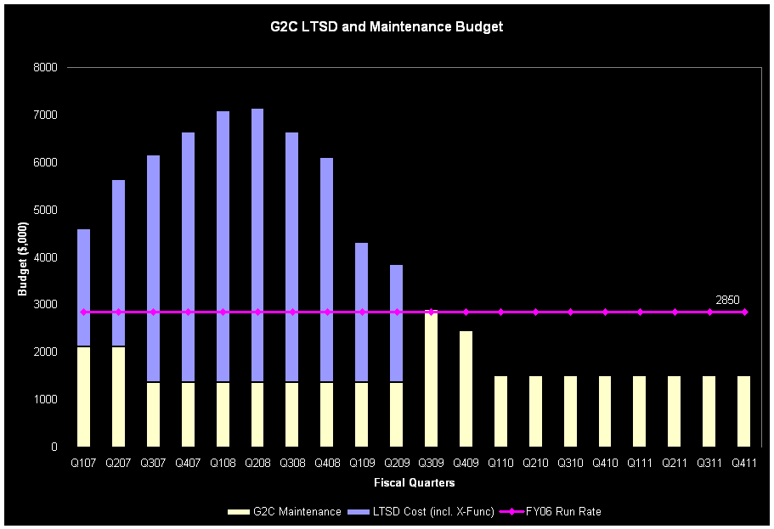
ROI project summary
Feb 2006
Vendor PoC begins
Sept 2006
Test Drive begins
Nov 2007
Testing Readiness
Apr 2008
Pilot Rollout Readiness
Sep 2008
Rollout begins
Feb 2009
Rollout ends
Incremental Budget Requirement of $12M in FY07, $15M in FY08, $2M in FY09
Current Run Rate of $12M per Year
Maintenance Cost Averages Only $7.3M per Year for FY07-FY09
Total Project Cost of $44M for FY07-FY09
Software Licensing Cost Not Include
Notes:
Incremental Budget Requirement is $29M across FY07-FY09. That breaks down to $12M in FY07, $15M in FY08, and $2M in FY09.
Even though the actual Test Drive project cost is $6M ($2.5M for Q1, $3.5M for Q2), because we are reducing our maintenance costs during this period, we need only $4.5M in incremental budget for these quarters over our current run rate ($1.7M in Q1, $2.8M in Q2).
Likewise, though the total LTSD project cost is $46M, reduced maintenance costs during the same period result in a much lower incremental budget requirement of $29M.
The vendors have indicated that the software licensing cost may be between $8-11M. We believe that figure is high, and that the VMO will be able to negotiate it down significantly from that point.

Slide 26
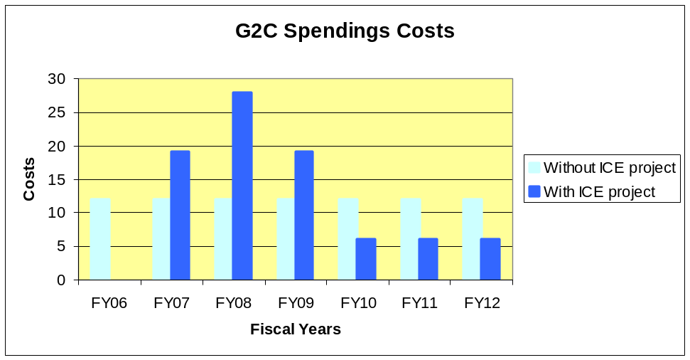
Project Cost ROI
Costs to recover $30M (without licence costs)
Yearly savings from FY10
Maintenance | 6
Productivity (10% of support costs) | 4.8
Overpayments | 5
Total | 15.8
Payback Period
23 Months

